Slide 1
Buckinghamshire, Oxfordshire and Berkshire West Integrated Care Board
Employee Structure Charts
6 January 2023

Slide 2
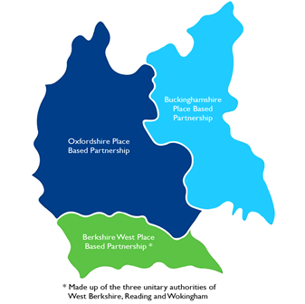
Buckinghamshire, Oxfordshire and Berkshire West system
NHS in BOB
Over 770 NHS organisations delivering services
£3.2 billion NHS funding in 2022-23
Employs more than 34,000 staff
NHS Services
GP Practices | 157
Community Pharmacies | 265
Dental Practices | 182
Ophthalmic Services | 151
Mental Health Trusts | 2
Acute/Integrated Hospital Trusts | 3
Urgent Care/Minor Treatment sites | 8
111, Ambulance & Transport | 1
Population = nearly two million people
Five upper tier local authorities, five district councils
More than 8,000 voluntary organisations

Slide 3
Executive Team Structure
Executive Leadership Structure
Band/Grade | FTE
VSM | 7
Total Cost | £1,372k
VSM = Very Senior Manager

Slide 4
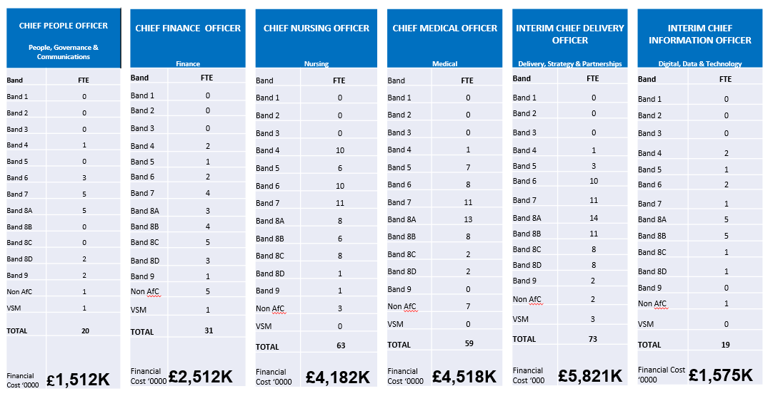
Information by Directorate, Band and Cost
The Information detailed below is drawn from Electronic Staff Records, as full time equivalents (in post) as at 31 December 2022
Non-AfC = not employed on Agenda For Change terms

Slide 5
ICB Staff Band Summary
ICB Totals
Band/Grade | FTE
VSM | 12
Non AfC | 19
Band 9 | 6
Band 8D | 16
Band 8C | 24
Band 8B | 34
Band 8A | 48
Band 7 | 43
Band 6 | 35
Band 5 | 18
Band 4 | 17
Total FTE | 272
Total Cost ‘0000 | £21,493

Slide 6
Executive functions by Directorate
Chief Executive Officer
Chief People Officer
Chief Finance Officer
Chief Nursing Officer
Chief Medical Officer
Chief Delivery Officer
Chief Information Officer
Corporate leadership
Partnerships
Strategy
Governance
System & ICB HR & OD support
System & ICB Learning and Development
Health and Wellbeing
Strategic OD to develop partnerships
Operational HR & payroll
System focused workforce planning & strategy
ICS & ICB Leadership development
Communications & Engagement
Corporate Reporting & Management
Accounts & ICB Estate
Financial Services & Audit
Contracting
Financial Planning, Programme Costing and Contract Support
Specialist Commissioning
ICS/Place Based support
Clinical leadership
Compliance, safety & serious incidents
Safeguarding, quality & safety
Clinical & performance risk
Patient voice & experience
Infection Prevention & Control
Maternity
Mental Health
Children & Young People
Personalise Care & Continuing Healthcare
Vaccinations
Learning Disabilities &Autism
Clinical leadership
Primary Care
Clinical Effectiveness
Medicines Optimisation
Clinical Network and Pathway Development
Patient Safety
Pharmacy, Optometry & Dentistry
Reducing Disparities in Clinical Outcomes
Cancer
Sector teams: Community; Urgent & Emergency care, Elective care
Place development & delivery
Planning, Performance, Assurance
Cancer Performance
EPPR Incident - Ops Centre
Corporate IT
Digital Strategy
Analytics, Inc Population Health management
Information Governance
GP IT

